Slide 1
Hoodies
catalogues
YuvAweaR

Slide 2



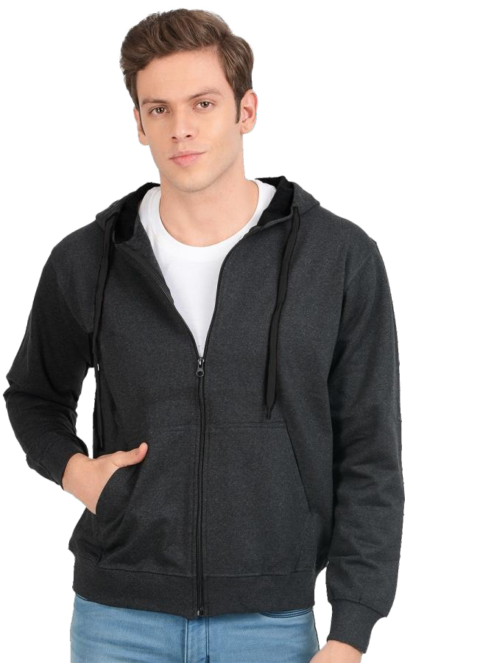
YuvAweaR

Slide 3


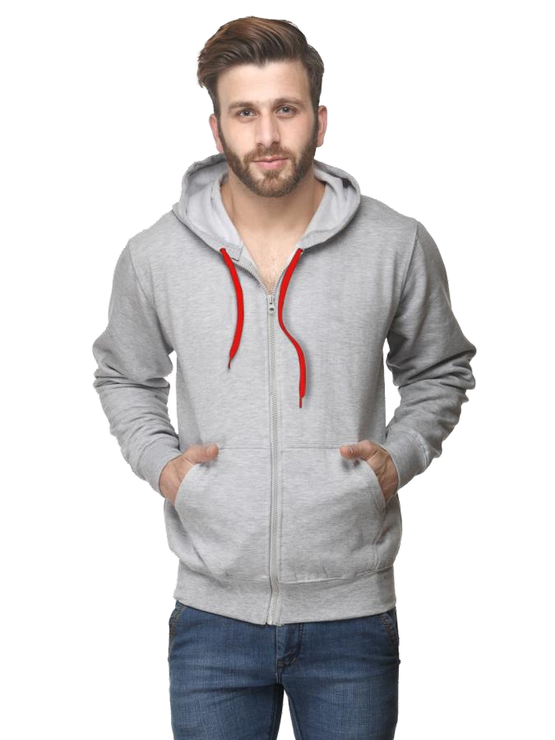
YuvAweaR

Slide 4


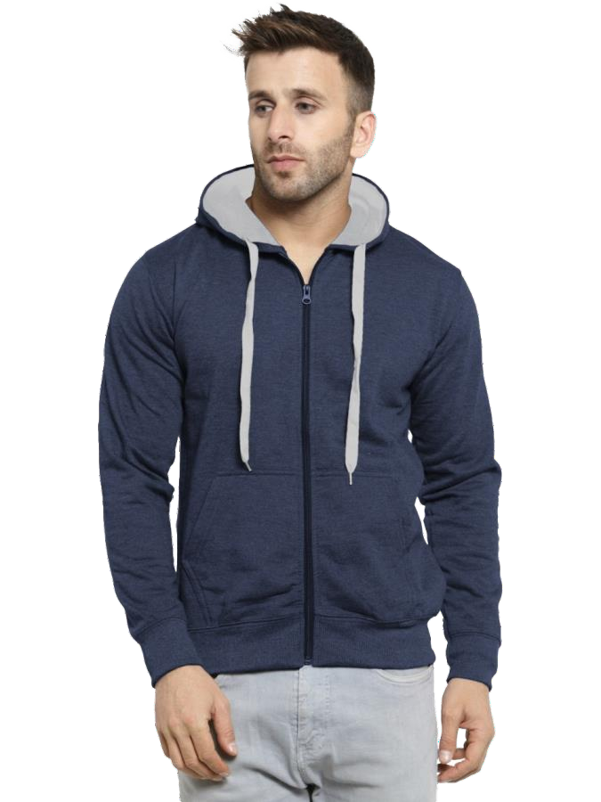
YuvAweaR

Slide 5


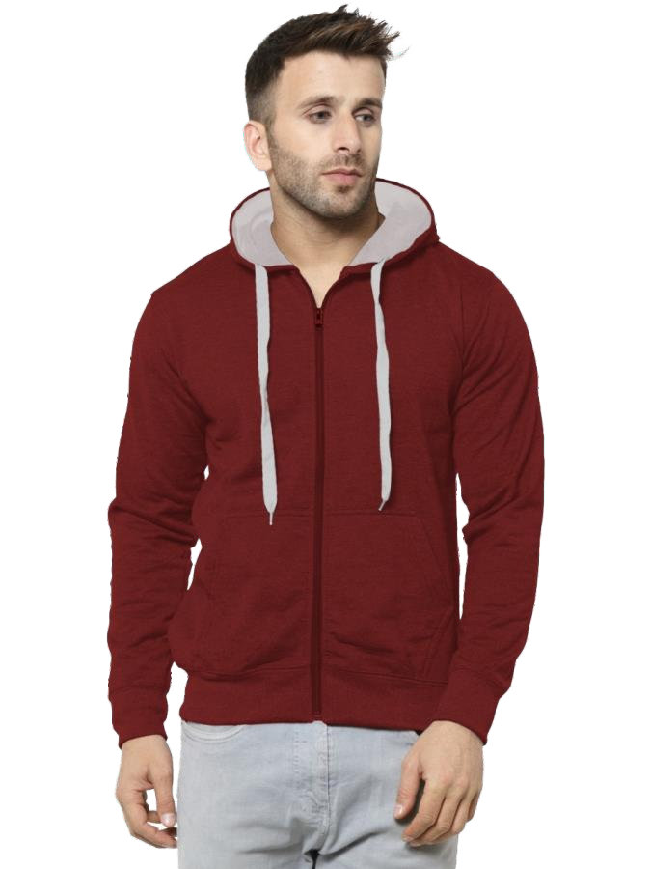
YuvAweaR

Slide 6


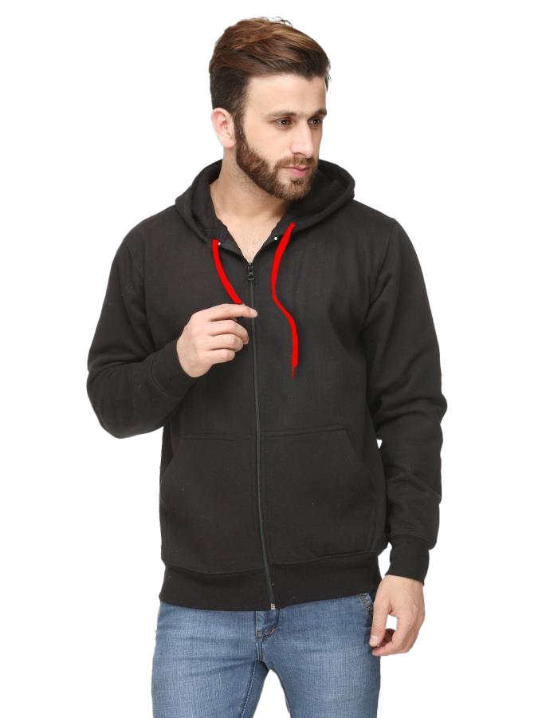
YuvAweaR

Slide 7


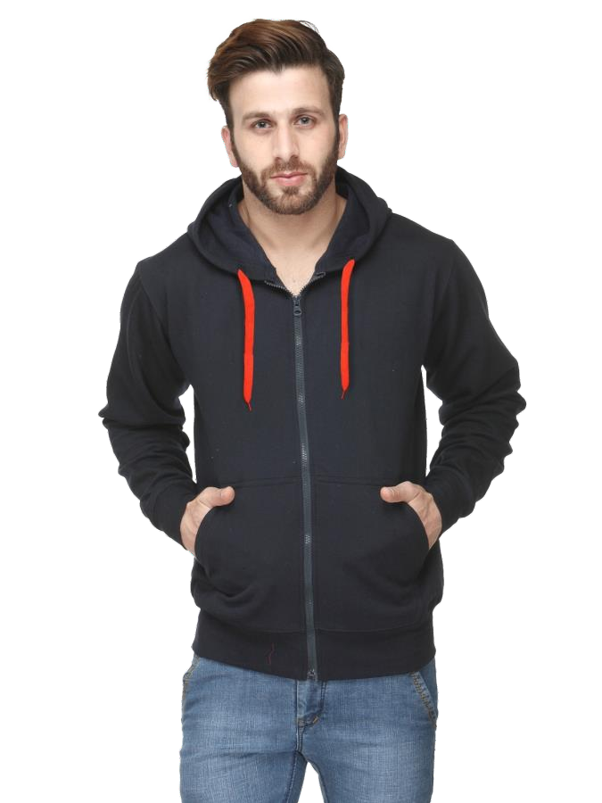
YuvAweaR

Slide 8

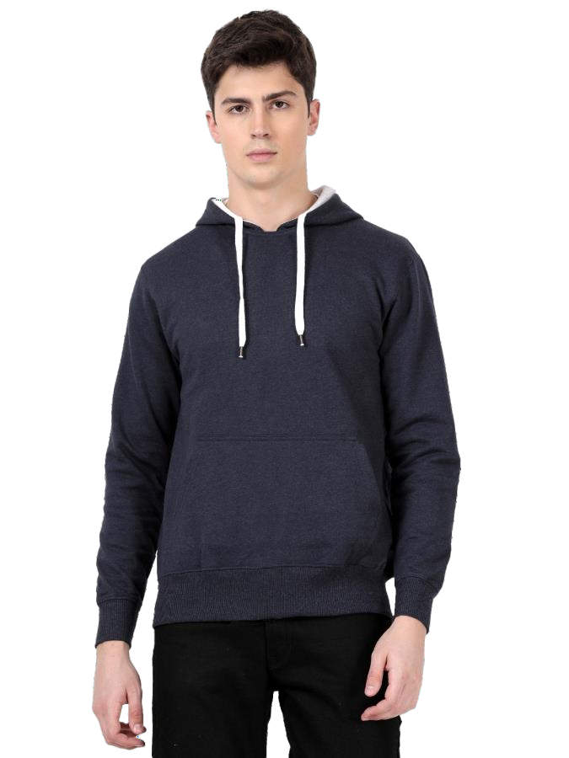
YuvAweaR

Slide 9


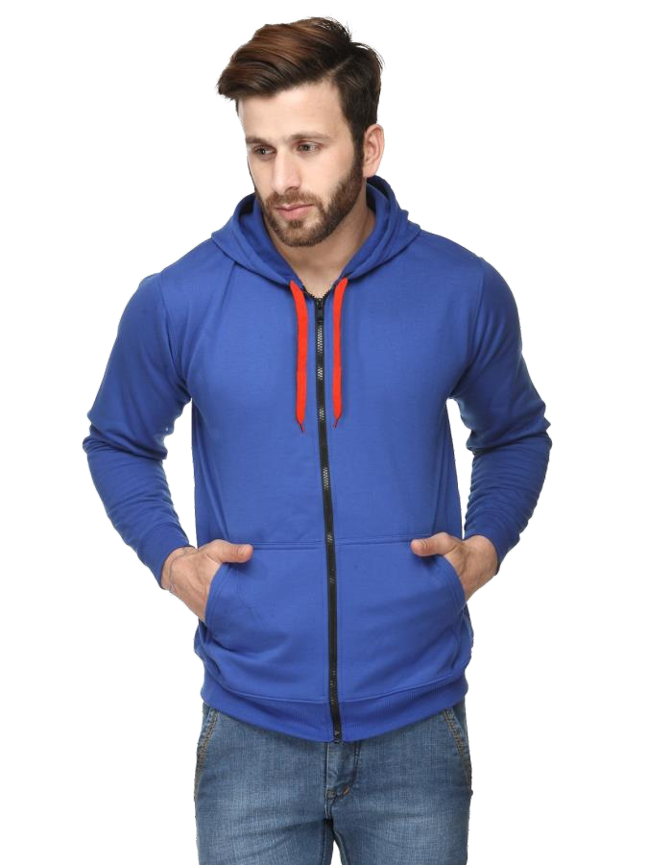
YuvAweaR

Slide 10

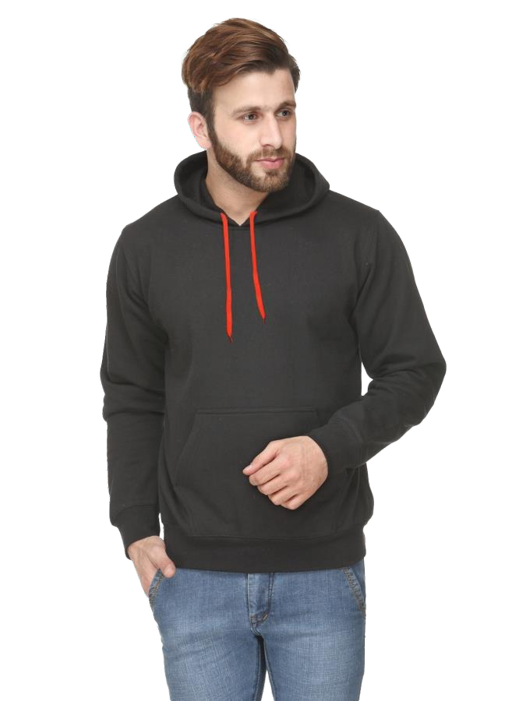
YuvAweaR

Slide 11

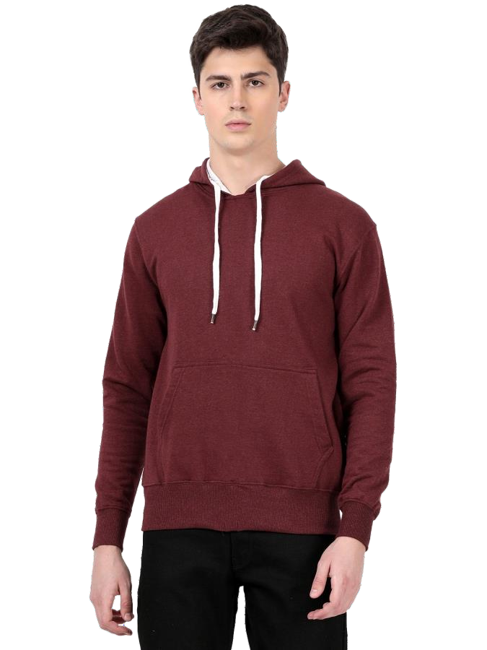
YuvAweaR

Slide 12


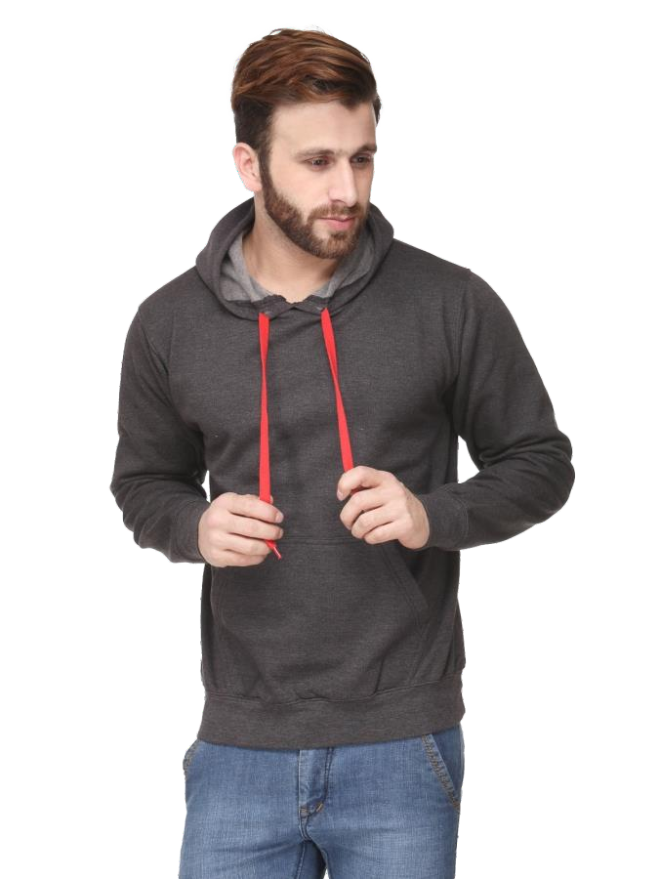
YuvAweaR

Slide 13

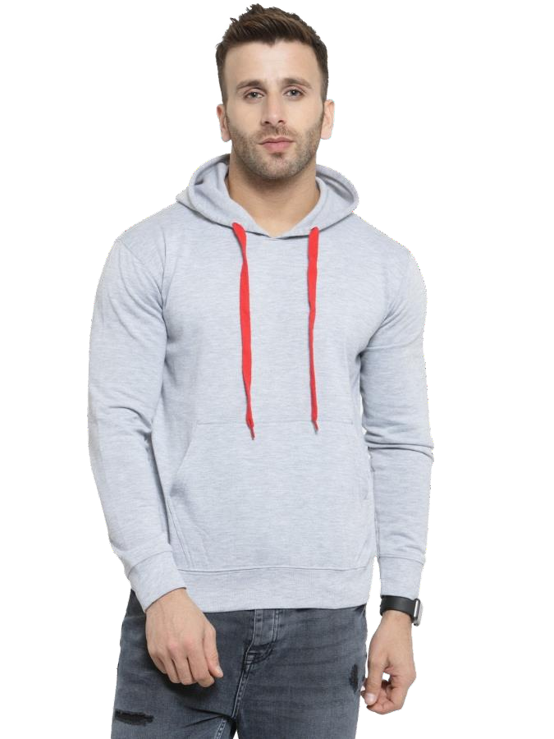
YuvAweaR

Slide 14

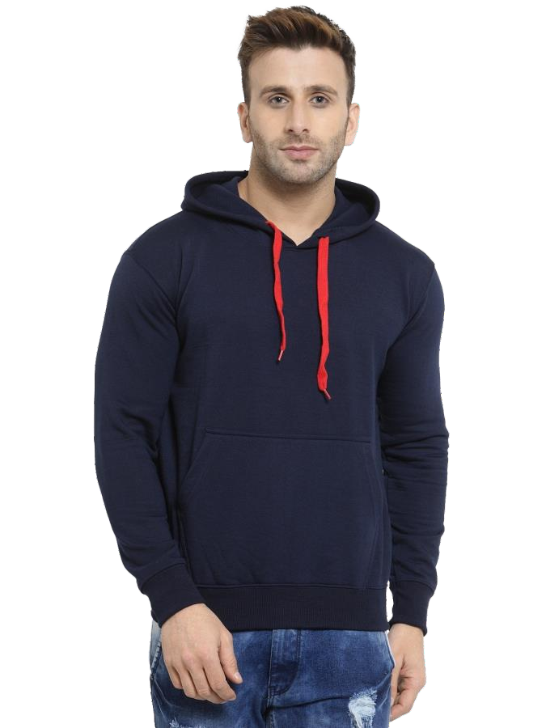
YuvAweaR

Slide 15


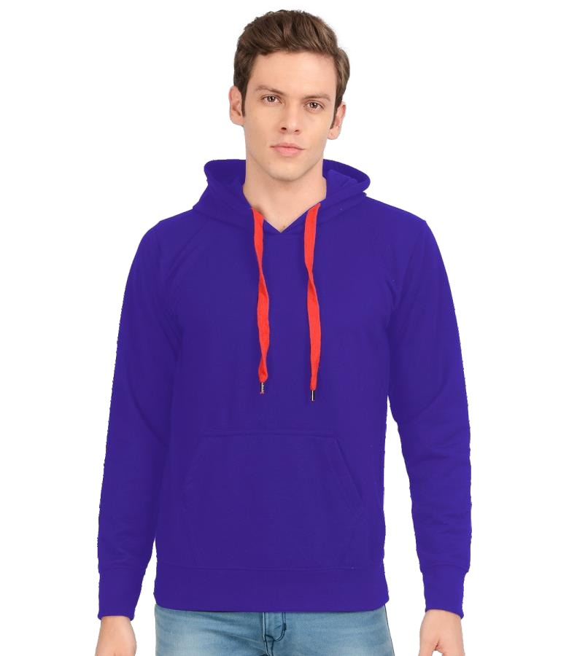
YuvAweaR

Slide 16

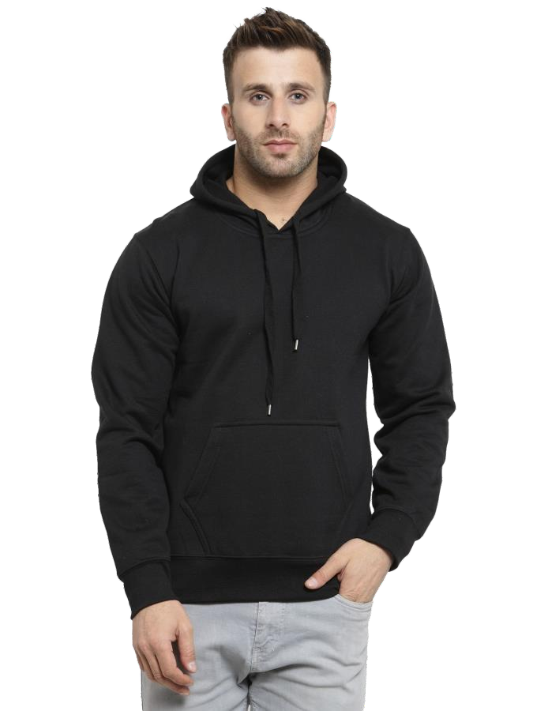
YuvAweaR

Slide 17

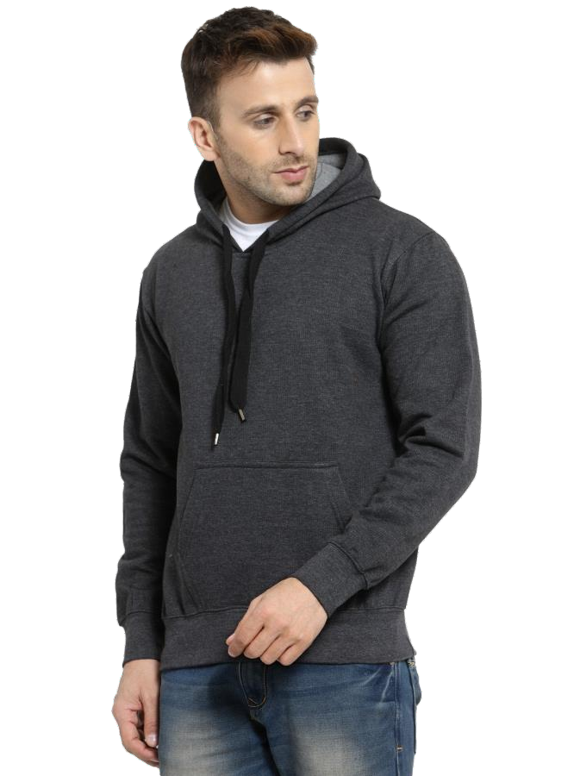
YuvAweaR

Slide 18

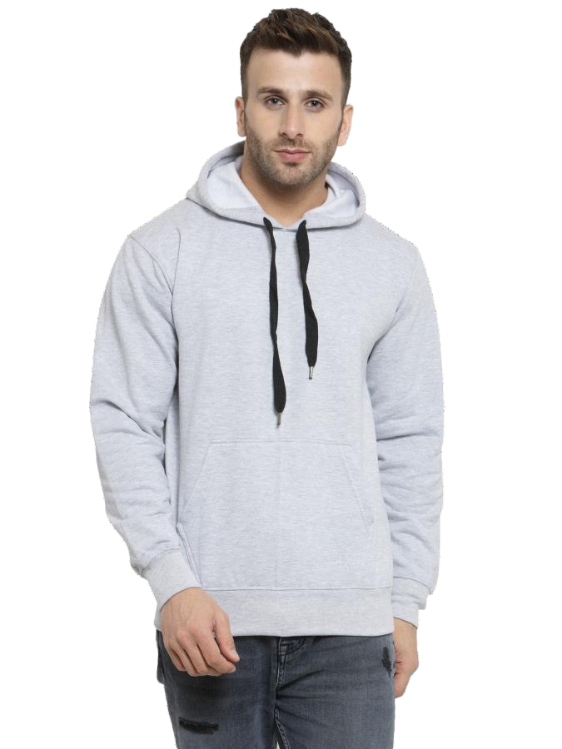
YuvAweaR

Slide 19

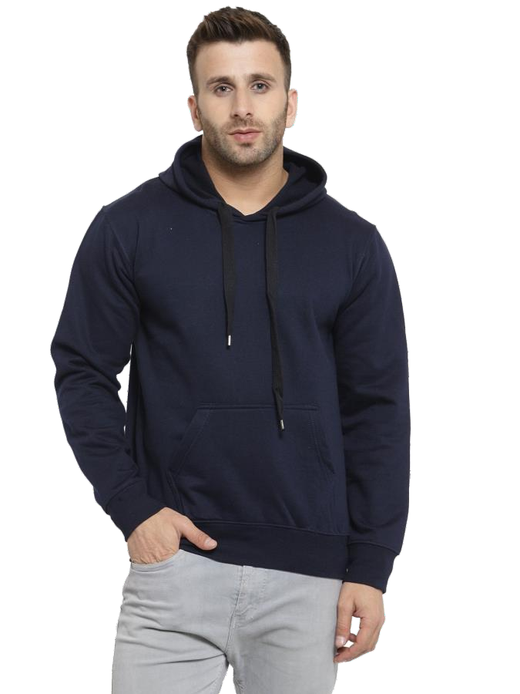
YuvAweaR

Slide 20

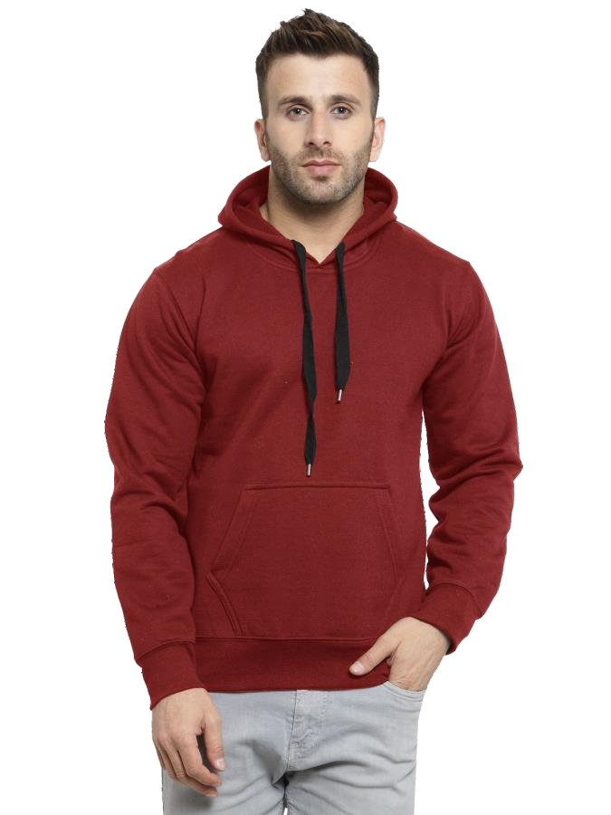
YuvAweaR

Slide 21

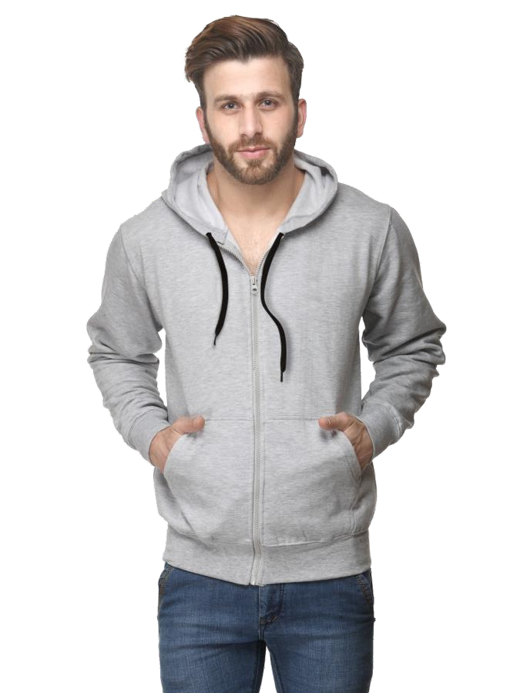
YuvAweaR

Slide 22


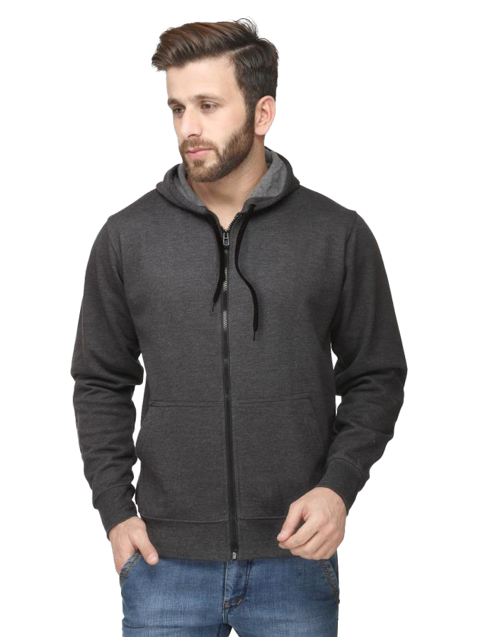
YuvAweaR

Slide 23

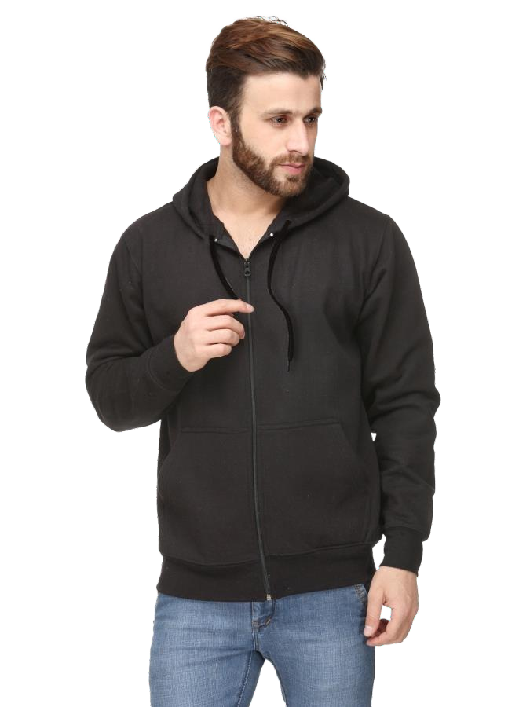
YuvAweaR

Slide 24


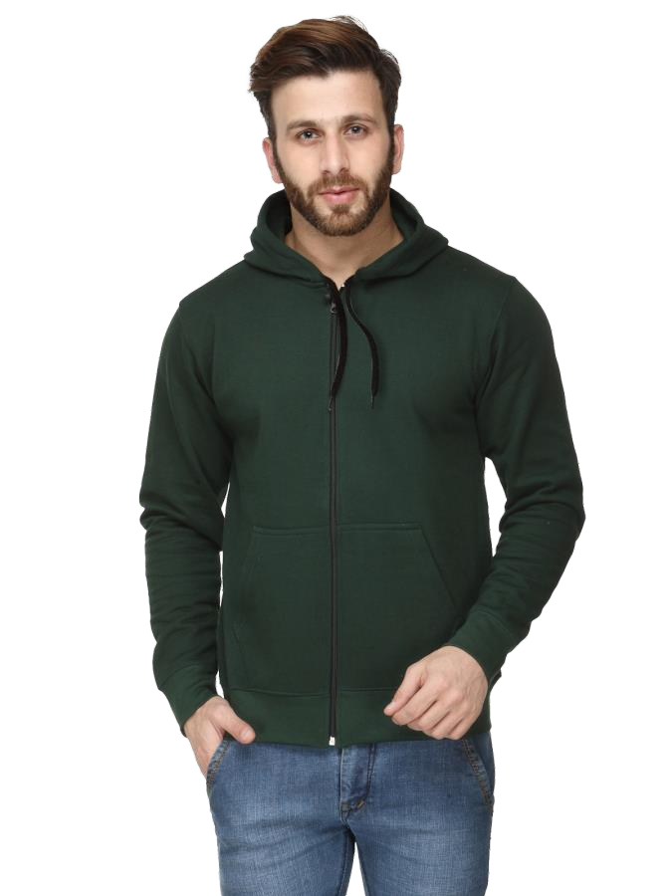
YuvAweaR

Slide 25

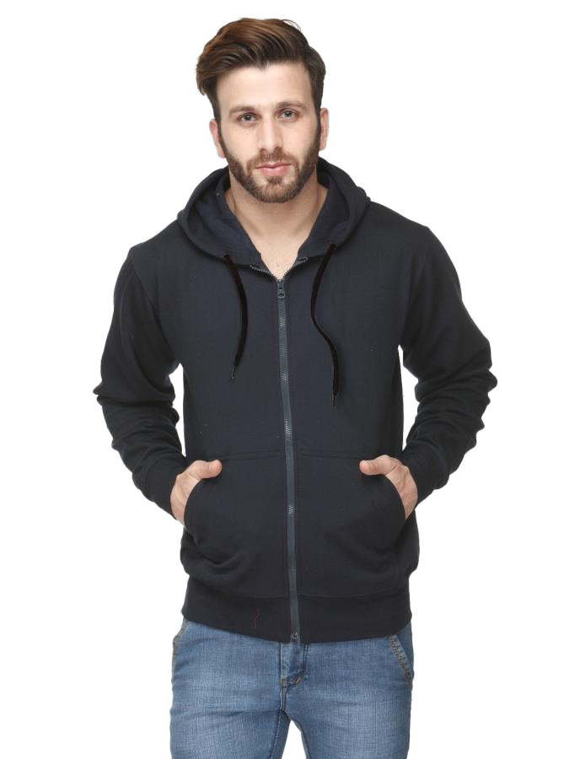
YuvAweaR

Slide 26


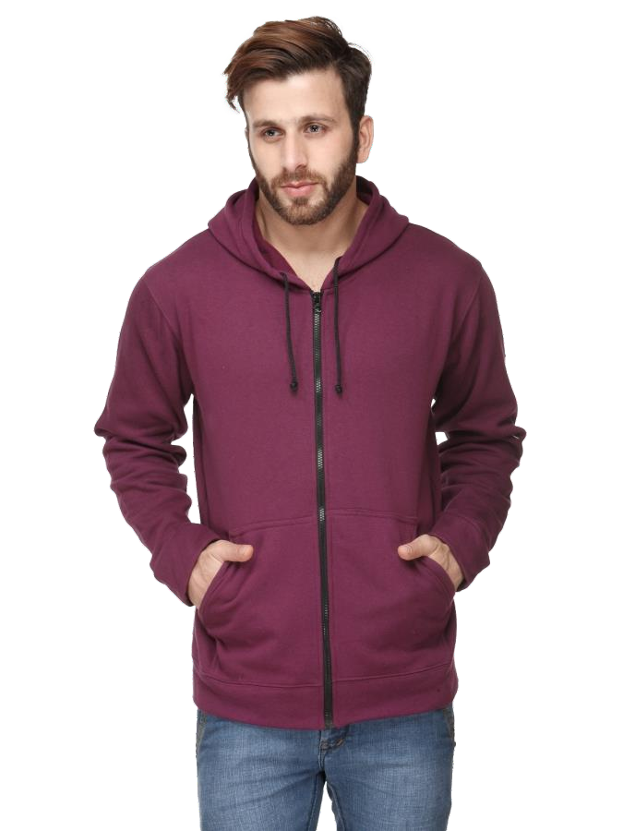
YuvAweaR

Slide 27


YuvAweaR
contact us
Email- info.yuvawear@gmail.com Ph no. +919266969958
www.locallygroomed.com

